Slide 1
Using Voorn-2013 or Rotary dataset
Omar Alamoudi

Slide 2
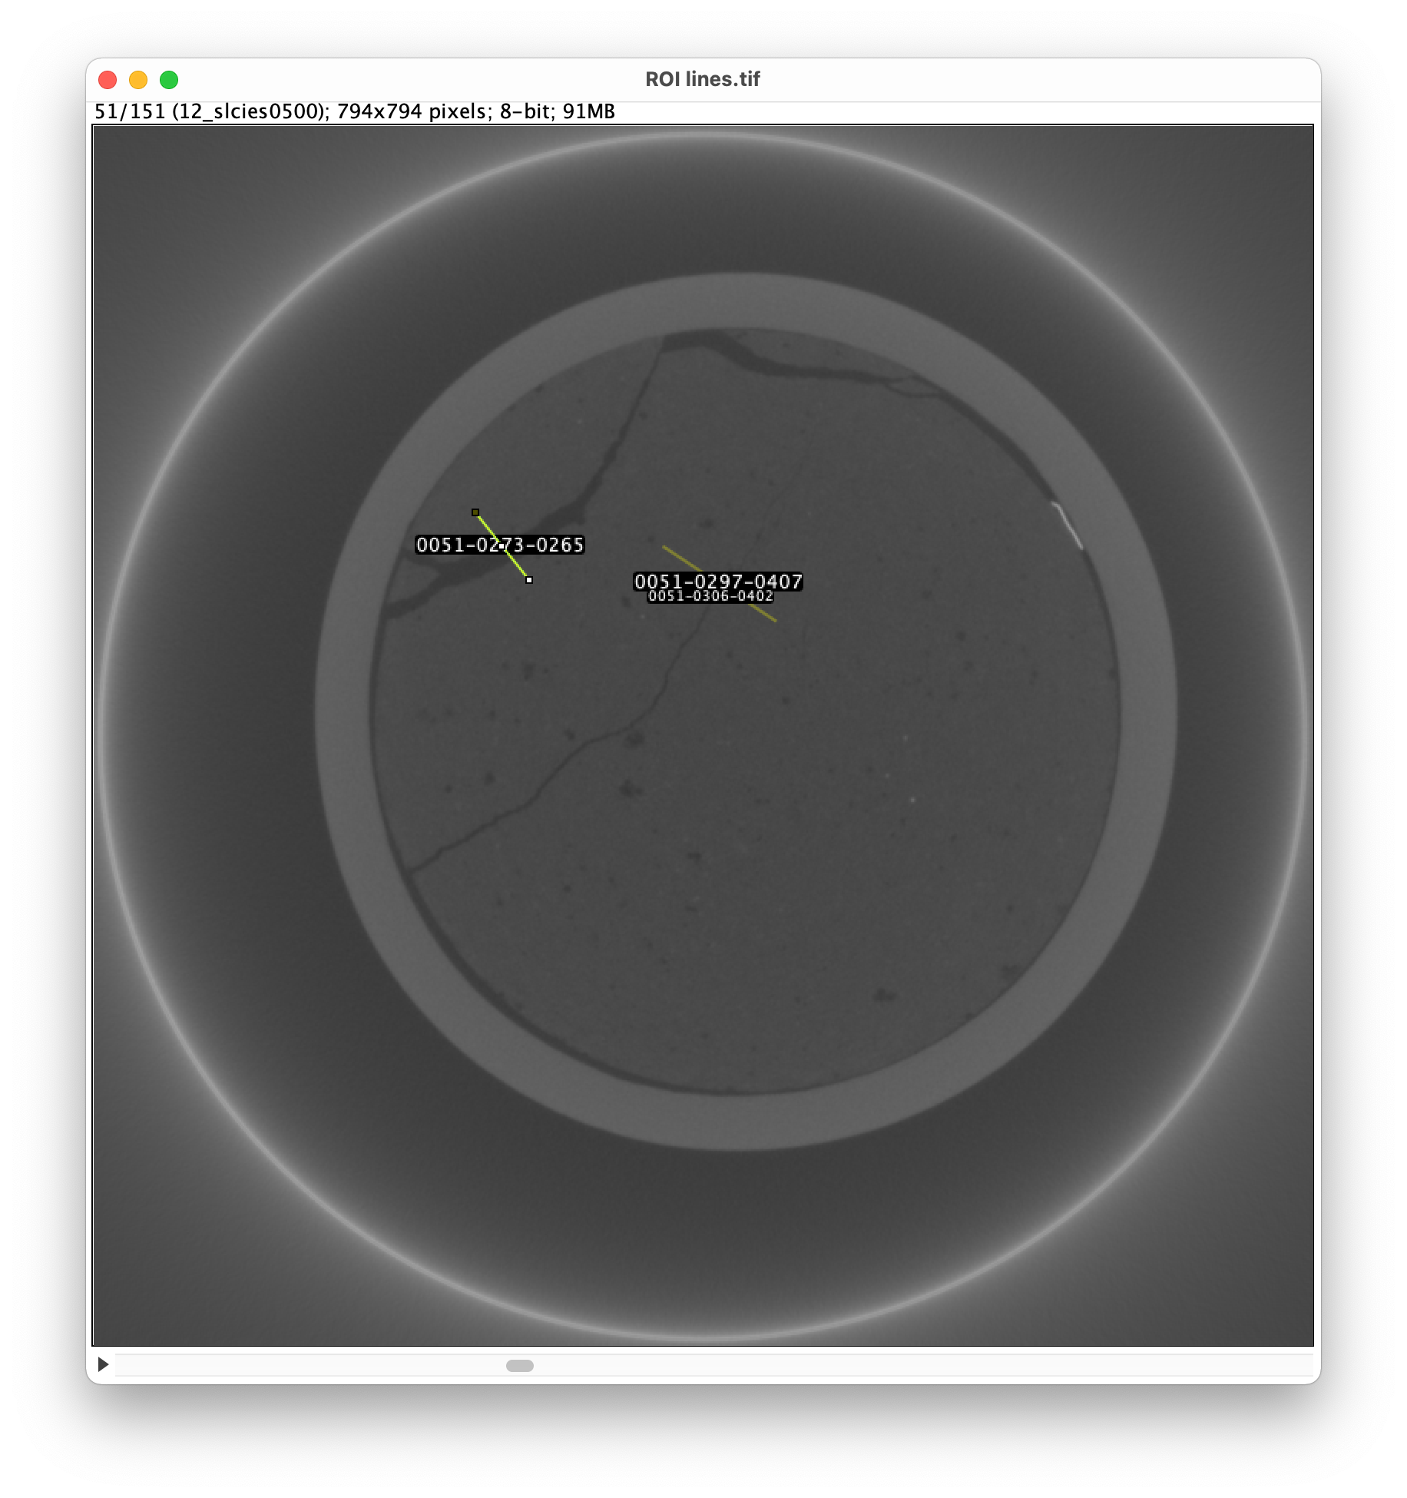
Determining the min and max values of s
150 slices (450-600)
Slice 51 (image name 500) is shown
Range of fracture sizes

Slide 3
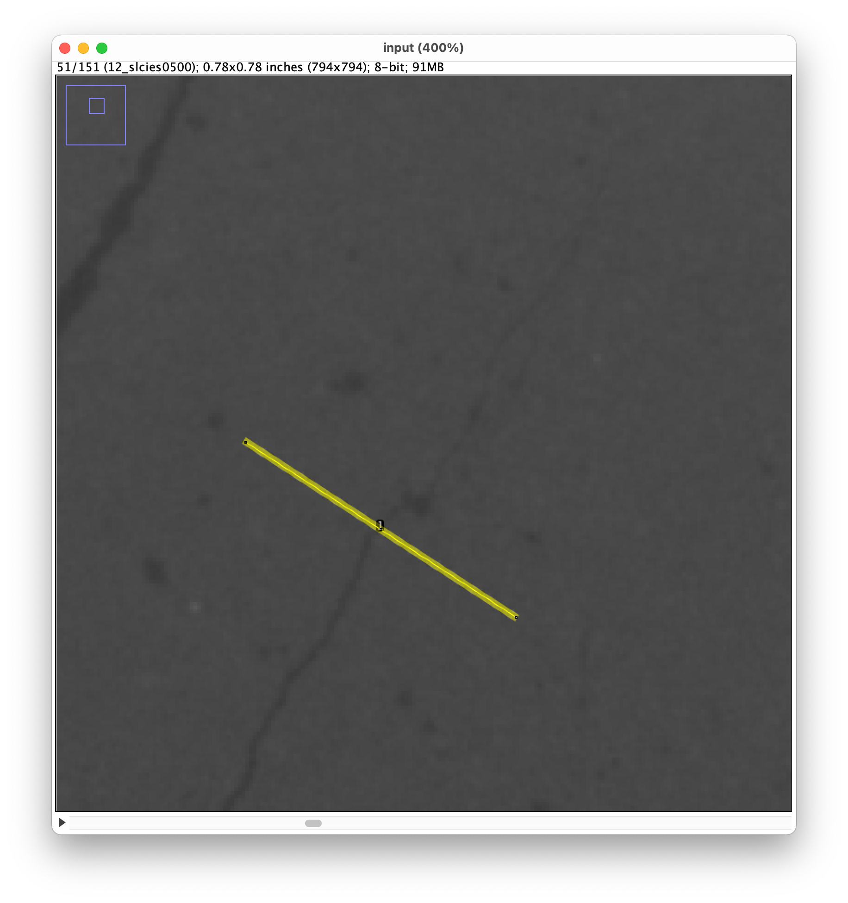
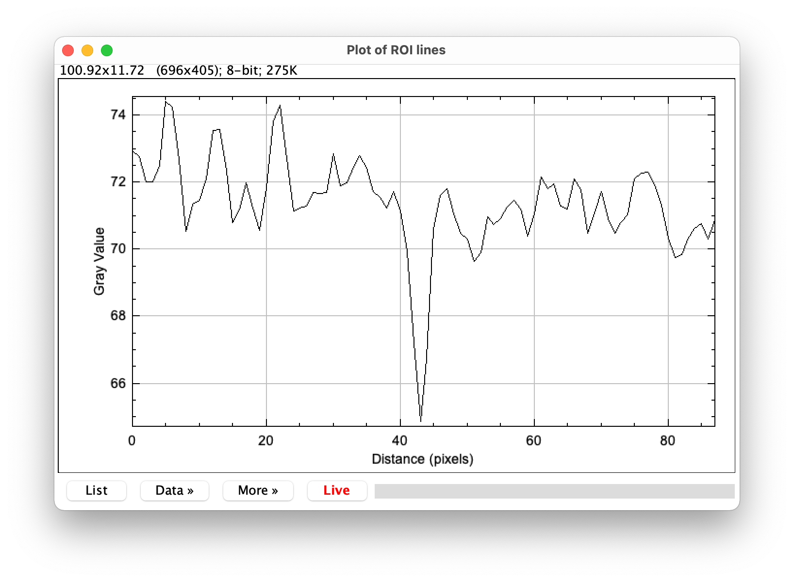
Determining the min and max values of s
Fracture

Slide 4
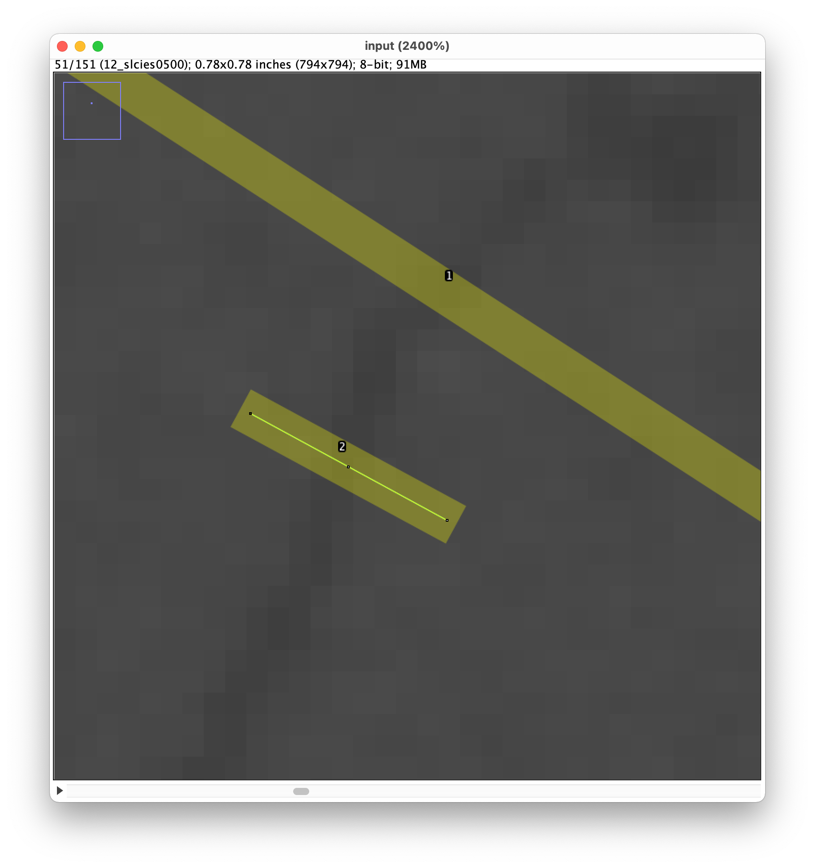
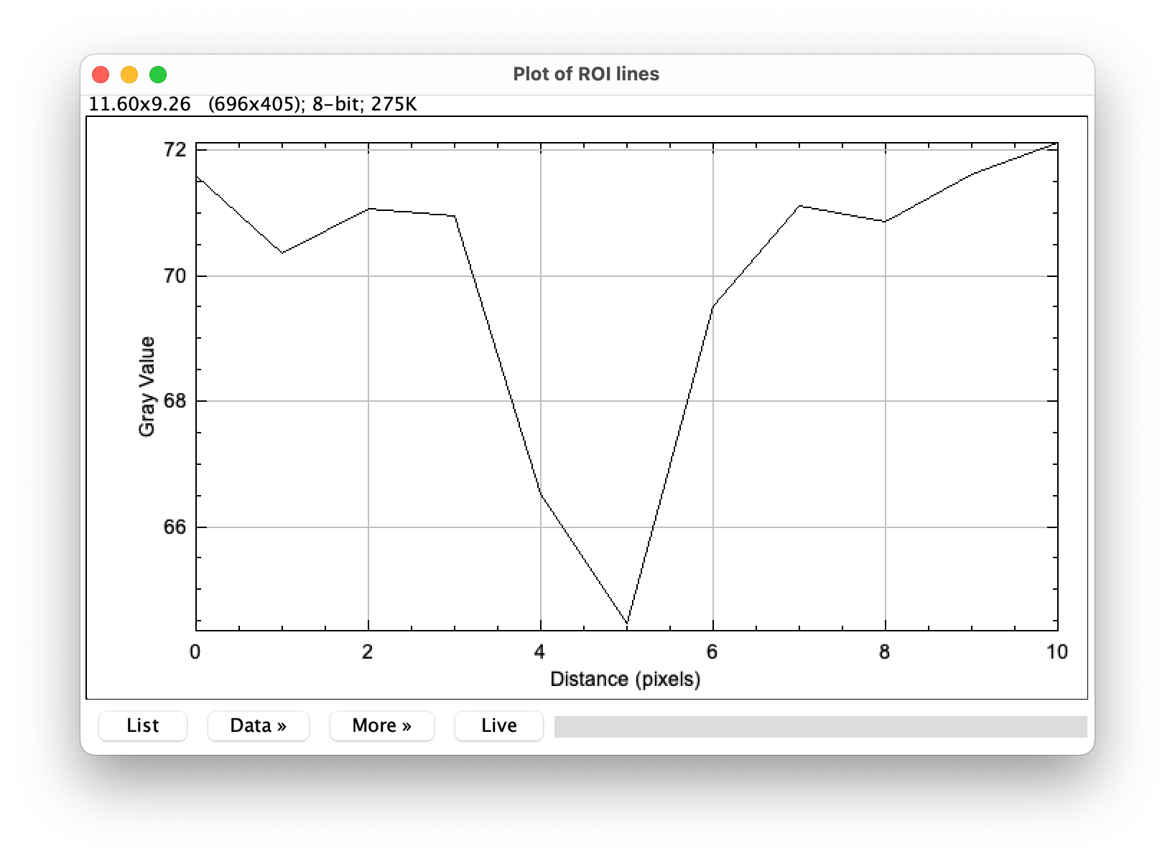
Determining the min and max values of s
s_min = 2
s_max =
Fracture

Slide 5
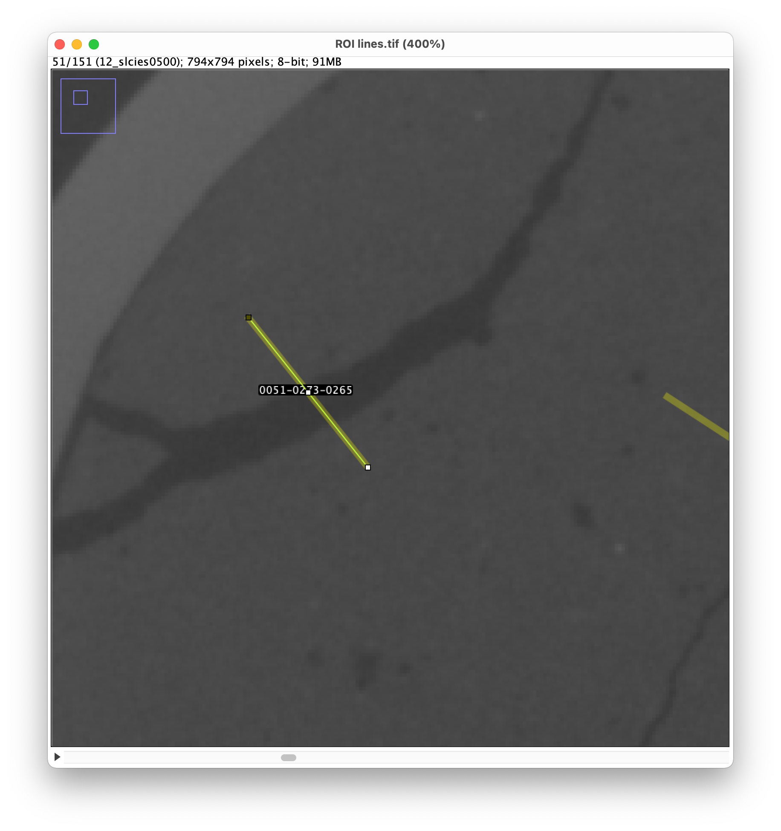
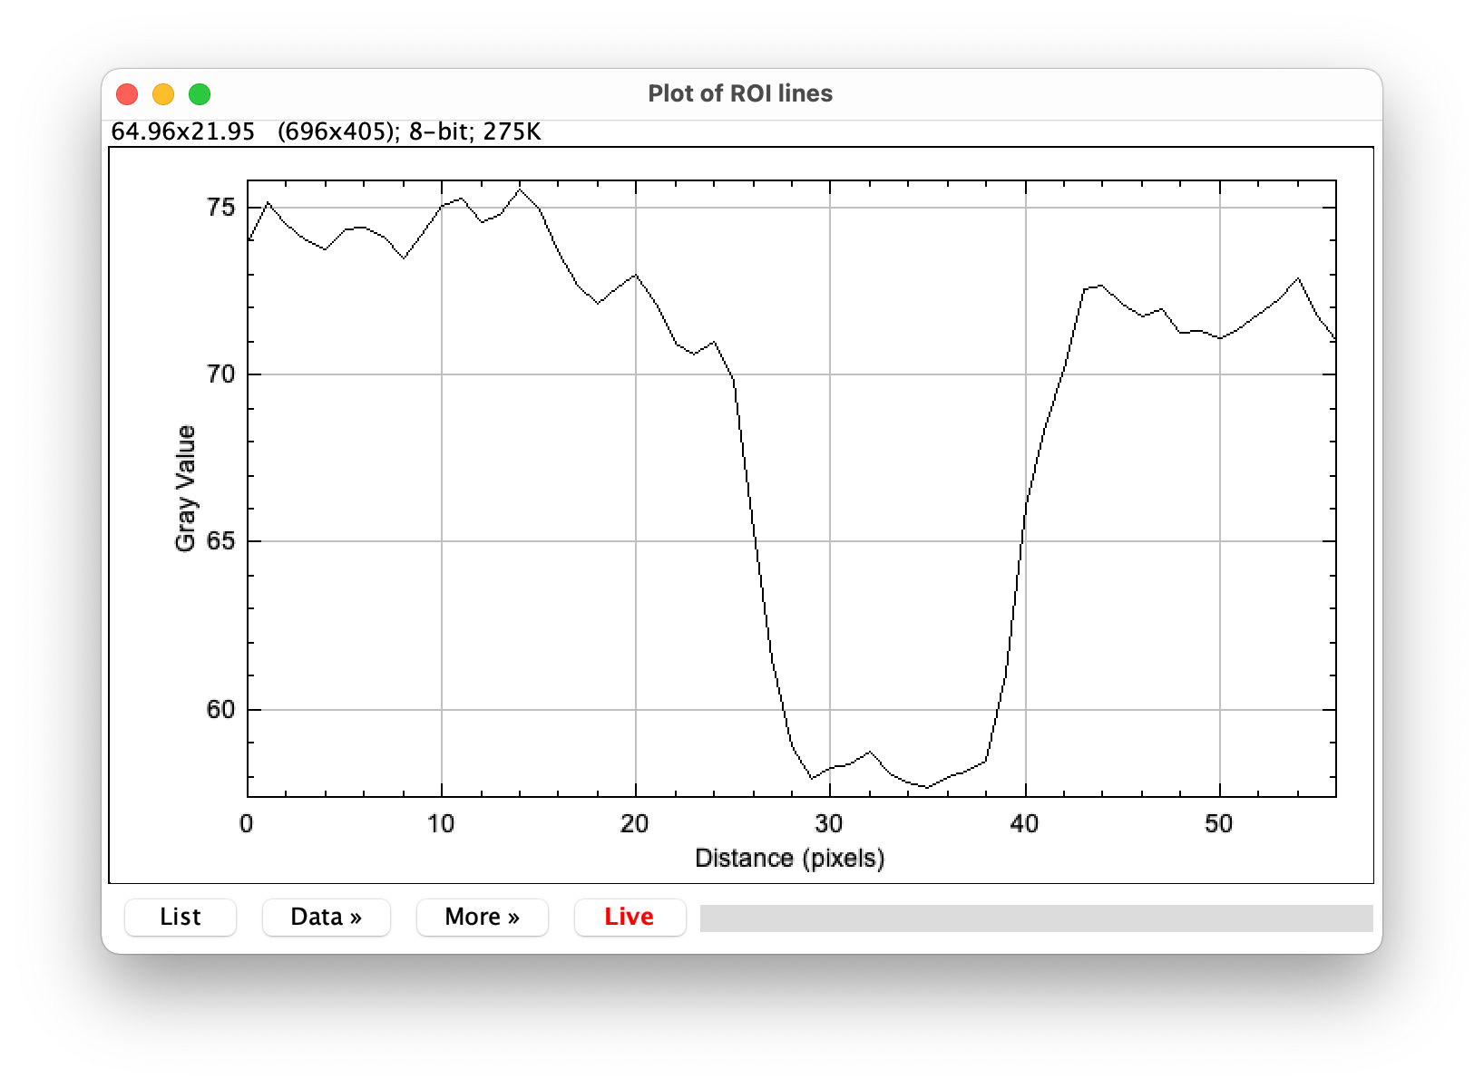
Determining the min and max values of s
s_min = 2
s_max = 12
Fracture

